Slide 1

Ranneeti 24
Strategic Management Challenge
Indian Institute of Technology (Indian School of Mines)
Six Sigma Project:
Optimizing Account Opening Process at Bank of XYZ
Submitted By:
Team Krishna
Shuvendu Pritam Das | 23mt0389@iitism.ac.in
Vipul Singh | 23mt0446@gmail.com
Prashant Kumar | 23mt0268@iitism.ac.in
Pradyumn Sharma | 23mt0263@iitism.ac.in

Slide 2
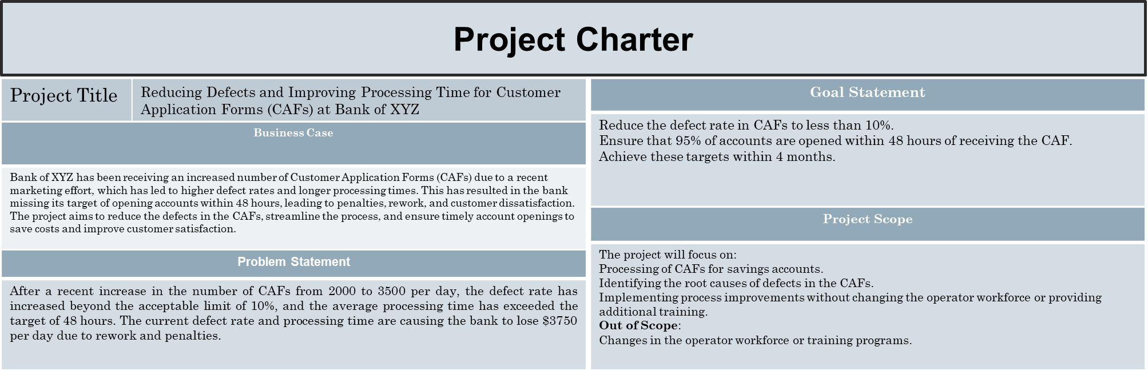
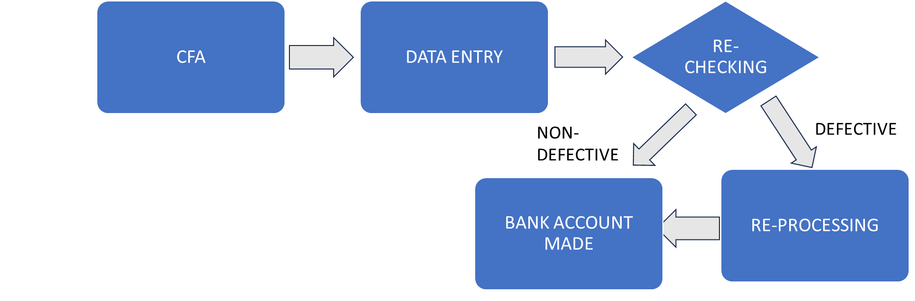
Define Phase

Slide 3
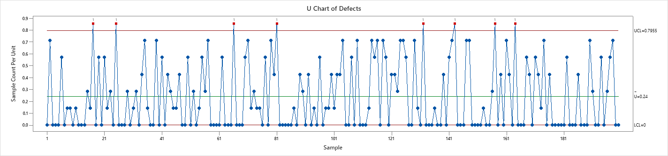
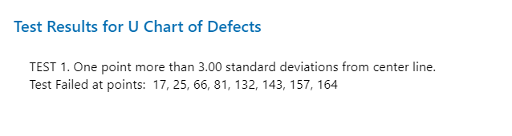
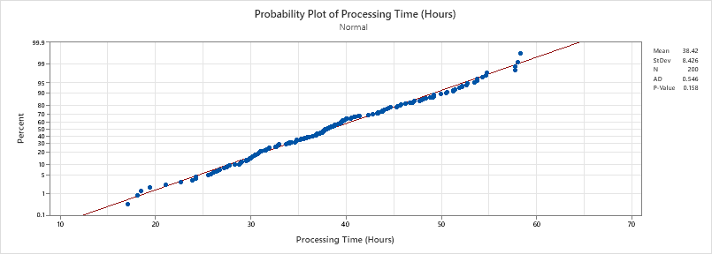
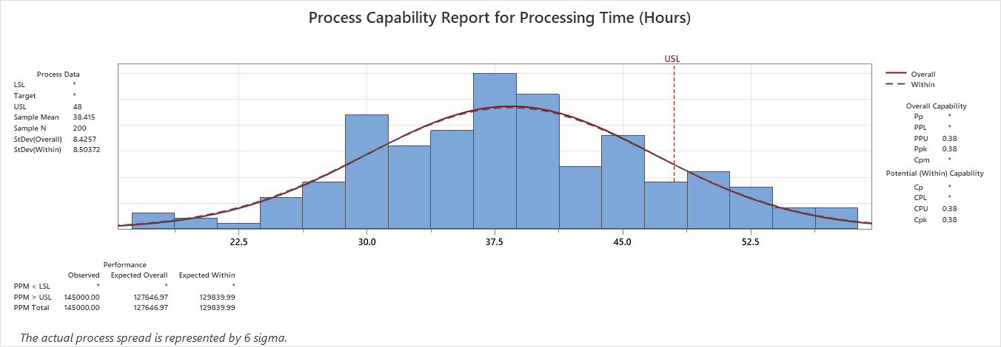
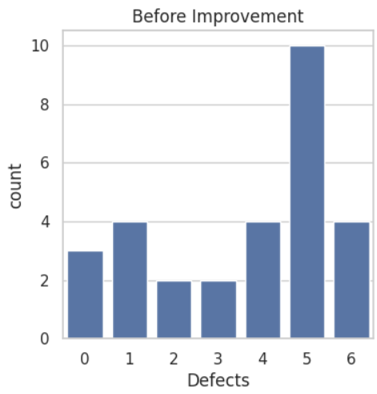
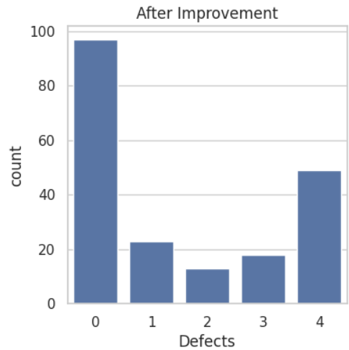
Measure Phase
Some data points are outside the control limits of U-charts which reflects there is some assignable cause in the process
Max defects per defective = 6 (before)
Initial
Defects = 336
Total Defect Opportunity = 1400
DPO = 0.24
Final
Defects = 299
Total Defect Opportunity = 1400
DPO = 0.21357
Max defects per defective = 4 (After)
The capability index of process is 0.38 which means our process is not capable achieving all process within target time(48hrs).

Slide 4
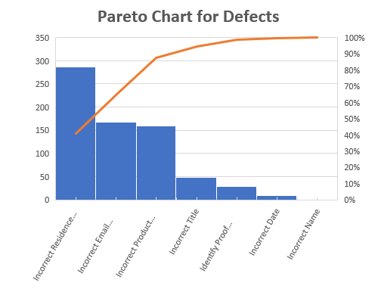
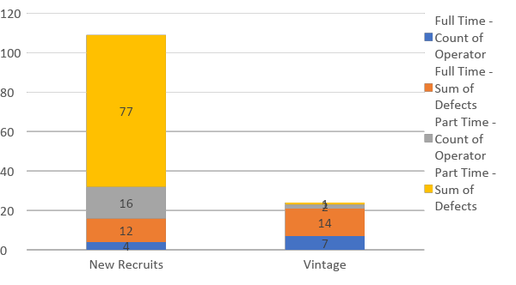
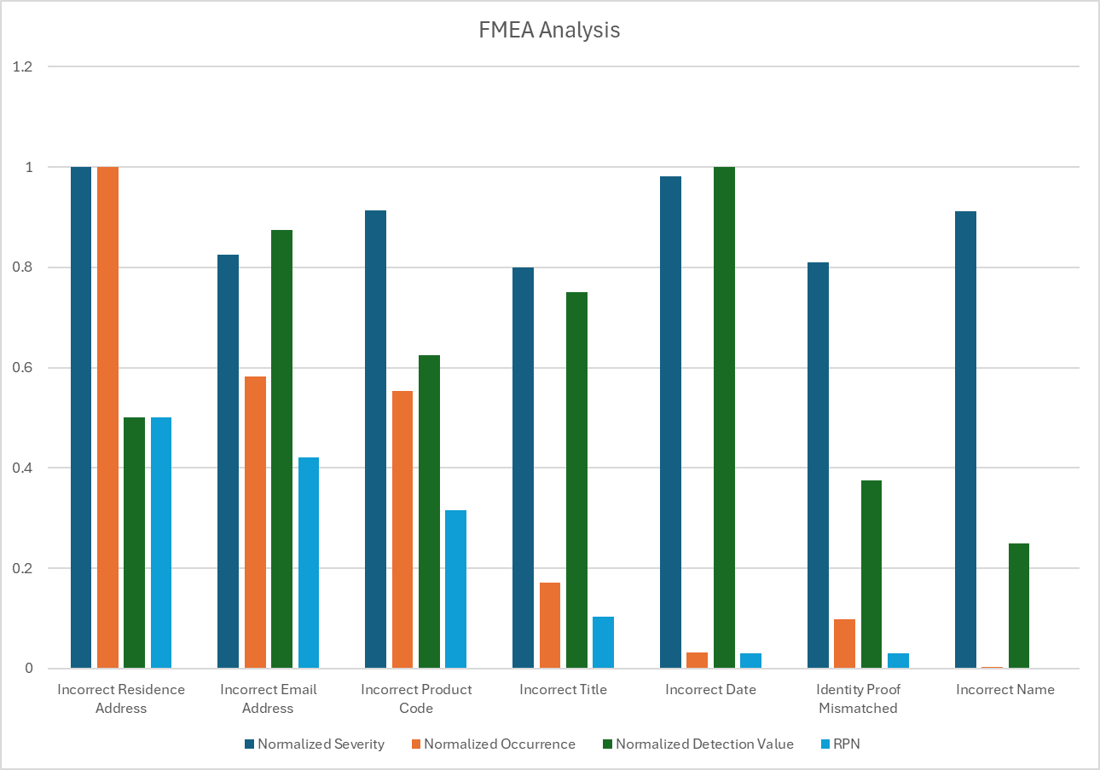
Analysis Phase : Identifying Root Causes
1
Defect Analysis
By performing Pareto Analysis, it can be inferred that 80% of the defects were due to “Incorrect Residential Address” and “ Incorrect e-mail Address”.
2
Processing Time Analysis
The highest processing time was for New Recruits working as Part timers and for the correction of “Incorrect Residential Address”
Factors | SSE | MSE | F | PR(>F)
Operator | 404.6276 | 404.6276 | 6.208428 | 0.013549
Operator_Type_of_Employee | 587.3724 | 587.3724 | 9.012384 | 0.003032
Training_Duration_Hours | 392.5628 | 392.5628 | 6.023311 | 0.014995
Operator:Operator_Type_of_Employee | 34.02169 | 34.02169 | 0.522014 | 0.470849
Operator:Training_Duration_Hours | 37.92802 | 37.92802 | 0.581951 | 0.446471
Operator_Type_of_Employee:Training_Duration_Hours | 0.624464 | 0.624464 | 0.009582 | 0.922124
Operator:Operator_Type_of_Employee:Training_Duration_Hours | 40.68749 | 40.68749 | 0.624291 | 0.430417
Residual | 12708.91 | 65.17392 | NaN | NaN
3
Statistical Analysis
Using ANOVA analysis, it is observed that Operator, Operator type and Training Duration has significant influence on number of defects and processing time.

Slide 5
Improvement Phase: Process Improvement Solutions
Process Simplification Through ID Proof Linking
Task Division for Enhanced Efficiency
Possibility of Adding Automation
Automate Data Entry: Implement Optical Mark Recognition (OMR) technology or online forms to minimize human error and speed up the data collection process. This can eliminate the need for manual entry, reducing processing time and enhancing accuracy.
Integrate ID Verification: Use automated systems to verify ID proofs, ensuring the data is accurate and reducing the need for customers to fill out forms manually.
Data Extraction from ID Proofs: Link the account opening process directly to ID verification. By extracting necessary data (like name, address, and identification number) from the ID, the need for customers to fill out extensive forms is eliminated, streamlining the onboarding process.
Reduce Errors: By relying on official ID proofs for critical data, the likelihood of errors—especially in residential address fields—can be significantly reduced
Segmenting Responsibilities:
Assign complex and error-prone tasks (e.g., verifying residential addresses) to experienced "Vintage-Full Time" operators who are more skilled at identifying and correcting potential defects.
Delegate simpler, less error-prone tasks to "New Recruits - Part Time," allowing them to benefit from the learning curve while ensuring overall productivity remains high.

Slide 6
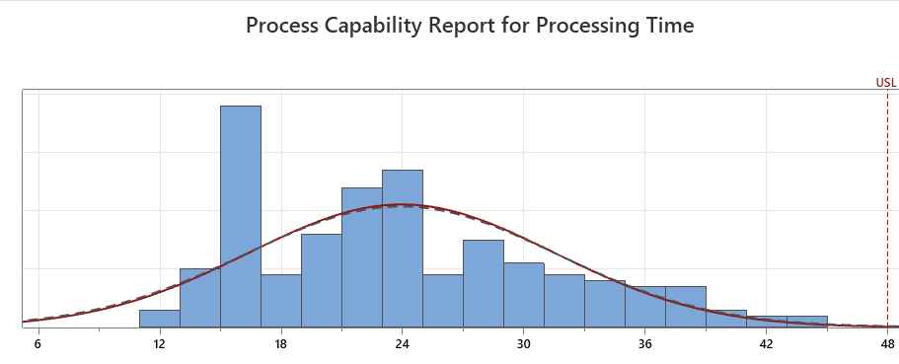
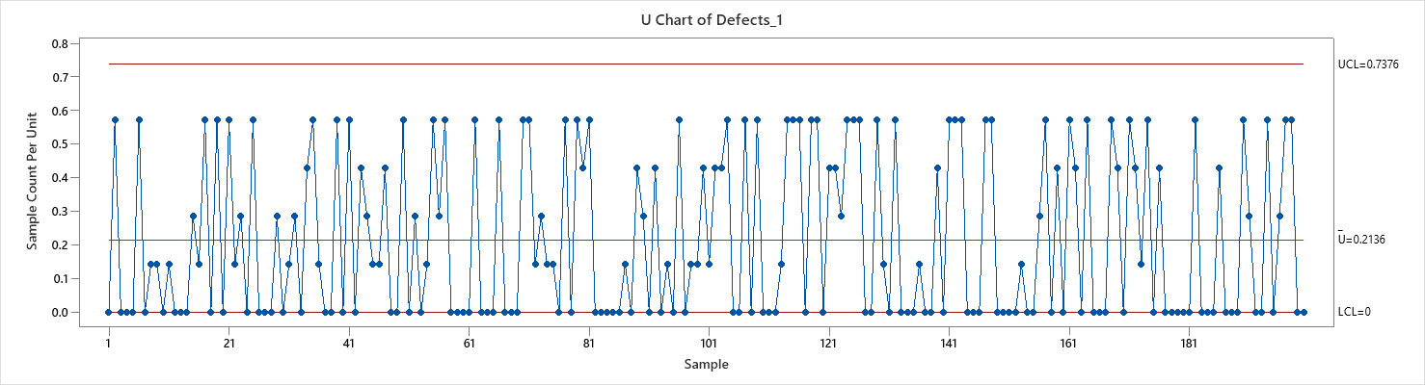
Control Phase
Continuous Improvement and Monitoring
Feedback Loop: Implement a feedback mechanism to monitor the effectiveness of the changes and identify areas for further improvement. Regularly review error rates and processing times to assess the impact of automation and task division.
The Process Capability Index (Cpk) has shown significant improvement, indicating that our recent enhancements have effectively increased operational efficiency and accuracy.
This metric will serve as a crucial tool for monitoring performance and guiding future improvements.
By regularly analyzing the Cpk, we can make informed, data-driven decisions to ensure continued progress and maintain high operational standards

